Slide 1
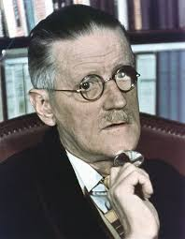
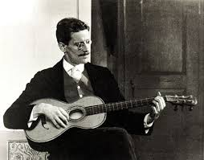
SIGNIFICANT DATES FOR JAMES JOYCE

Slide 2
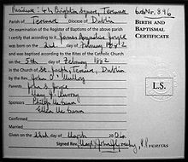
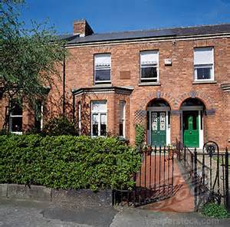
2ND FEBRUARY 1882
James Augustine Aloysius Joyce is born at 41 Brighton Square in Rathgar.
Joyce's birth and baptismal certificate

Slide 3
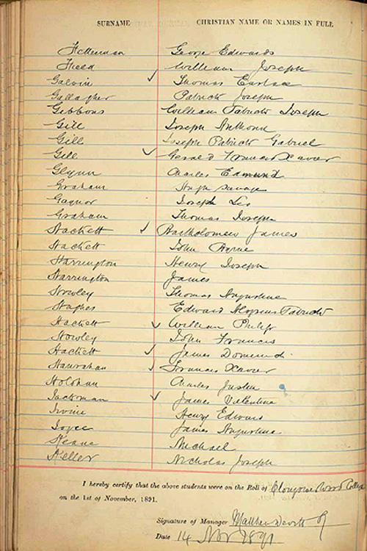
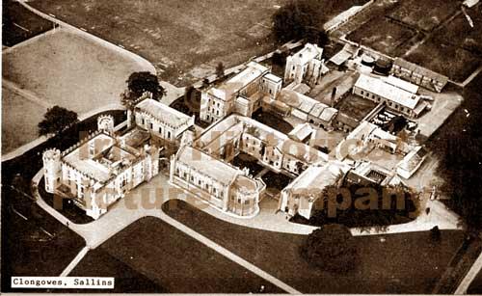
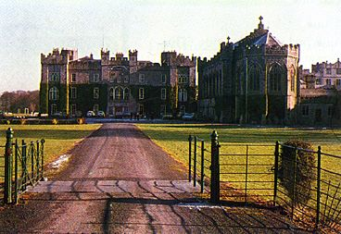
1888
Joyce is enrolled in Clongowes Wood College in Sallins, Co. Kildare.

Slide 4
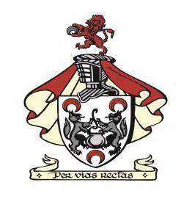
1893
After being forced to leave their Bray residence due to hardship, the Joyce family move to the North Inner City and Joyce becomes a student at Belvedere College

Slide 5
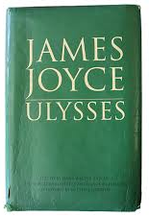
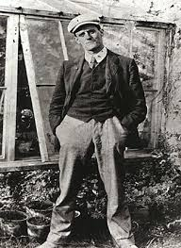
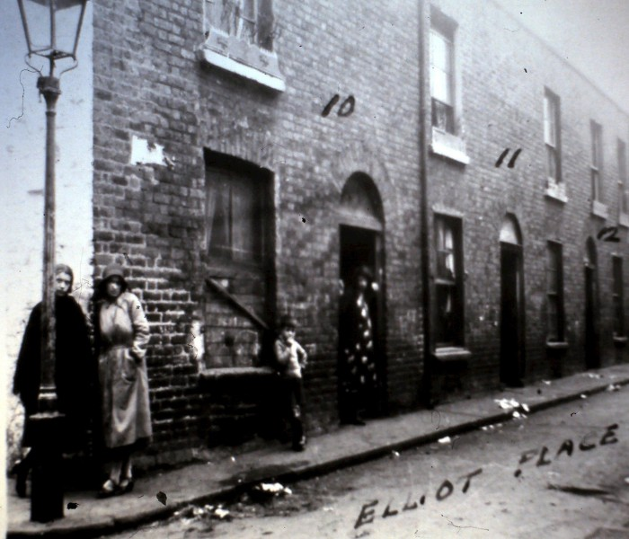
1896
While seriously contemplating joining a religious order, Joyce begins writing prose sketches and visiting the infamous brothels of ‘Monto’.
In Ulysses, the old Bawd’s cries outside the brothel in Monto. The brothel in Monto is a significant part in the book and as well in his personal life.

Slide 6
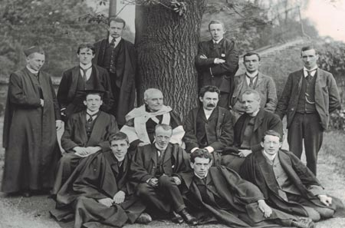
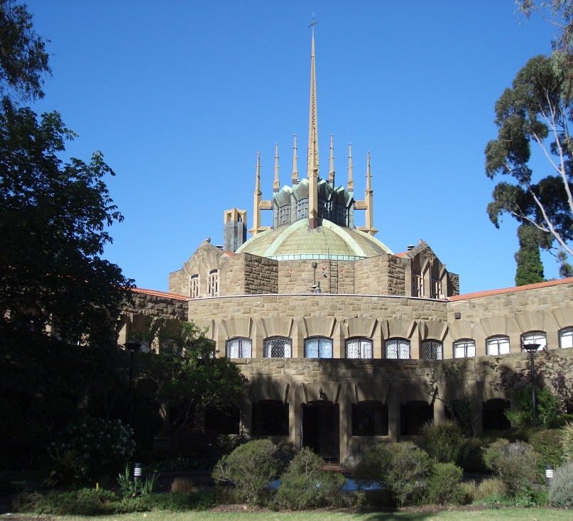
1898
Joyce enrolls in a degree at University College at Newman House, studying Modern European Languages.
UCD BA class of 1902, with professors. The class includes James Joyce (standing, second from left) and Felix Hackett, later professor of physics and electrical engineering (front row, left)

Slide 7
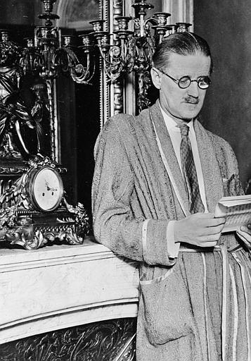
1902
Joyce receives his degree before enrolling in medical school in Paris and departing.

Slide 8
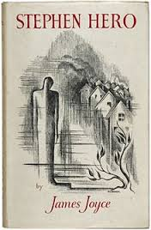
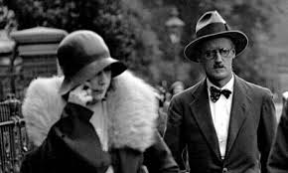
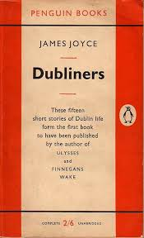
1904
Having returned home to care for his mother as she died, Joyce now meets his wife-to-be Nora Barnacle on July 10th. He also begins writing Dubliners and Stephen Hero.

Slide 9
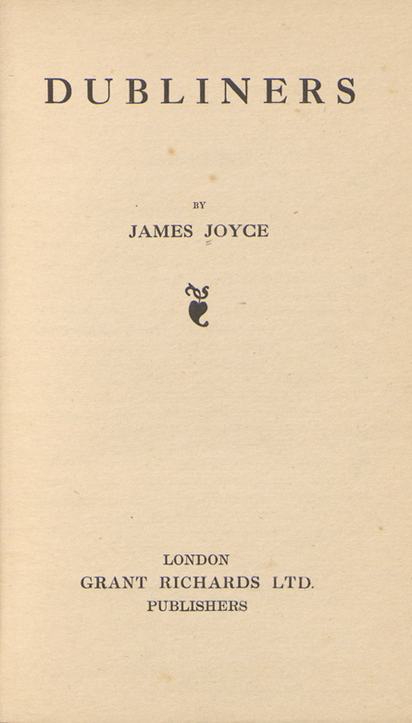
1914
Dubliners is finally published by Grant Richards in London.

Slide 10
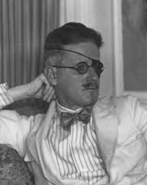
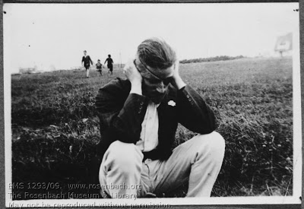
1917
Joyce’s glaucoma worsens and he undergoes the first of a series of eye operations.

Slide 11
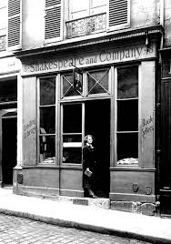
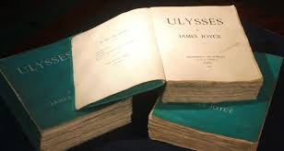
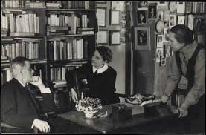
1922
A first edition of a thousand copies of Ulysses is published by Joyce’s friend Sylvia Beach, proprietor of the Paris bookshop Shakespeare & Co.

Slide 12
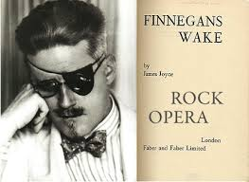
1939
Finnegans Wake is first published after a very long and protracted period of writing.

Slide 13
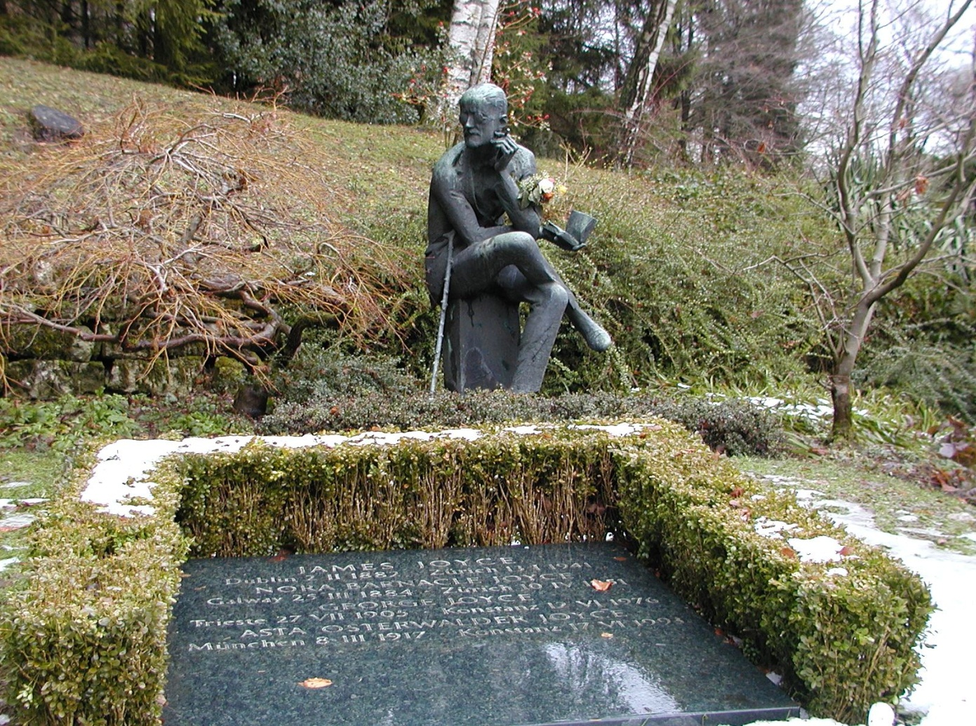
13TH JANUARY 1941
James Joyce dies of a perforated duodenal ulcer. He is buried in Fluntern cemetery, Zurich.

